Slide 1

JSS ACADEMY OF TECHNICAL EDUCATION, NOIDA DEPARTMENT OF ELECTRICAL ENGINEERING
Designing an EV Charging System for Improved Performance
Group No. 12
Supervisor
(Dr. Sanjiba Kumar Bisoyi) (Associate Professor)
Rishabh Khare (1709120079)
Sarthak Singh (1709120086)
Luv Pathak (1709120055)
Abhinav Kumar Singh (1709120003)

Slide 2
Outline of Presentation
Objectives
Introduction about EVs
Literature Survey
Description of Existing Method
Block Diagram
Timeline
References

Slide 3
Objectives
Complete the literature review for the proposed topic and identify the charger rating required.
To analyze the performance of different converters and select the most suitable converter.
To design the selected converter for the rating of the battery chosen with reduced THD and ripple content.
To develop safety circuit if required and complete the charging system design.

Slide 4
Introduction About EVs
Electric vehicles are a new and upcoming technology in the transportation and power sector.
The U.S. Energy Information Administration states that the world has an adequate crude oil supply until about 2050.
Basically, Electric vehicles are expected to enter the world market such that by 2030, 10% of the vehicles will be of EV type.
The most expensive part of an EV is the battery and its charging and maintenance needs to be taken care of.
The major challenges while adopting EV as an alternate to the fuel vehicles are the charging problems and its range from one charge.

Slide 5
Literature Survey
ChargePoint Home WIFI-Enabled Charger
This is a hardwired level 2 EV charger designed to suit a wide range of EV models. The charger is 18 feet long and charges up to six times faster than the standard wall outlet. The 240 V- and 32-Amp rating works well with a number of cars such as BMW, Jaguar, Toyota, Hyundai, Chrysler, Ford, Honda, Nissan, Tesla, etc. It can also be connected with your phone for easy control and monitoring.
2. FLO Home X5 Carbon
The FLO home X5 Carbon is a high-performance, CSA certified Level 2 smart charging system that charges five times faster than the standard models. This product features sturdy and high-quality construction and is compatible with all the EV models. The 240 V, 30 Amp rating and a 25-feet power cable ensures the best of efficiency and versatility with every car design.
3. Juicebox Pro 40 Lite
This is one of the high-power EV chargers you can find on the market. It comes in a 40 A, 10KW rating supplied by a 24-feet cable and is suitable both for indoor and outdoor installation. The Juicebox Pro is compatible with all the EV models since it automatically adjusts its power output depending on the car power rating up to 40 Amps. The rugged exterior design comes in a black-powder coated brushed aluminum that’s fireproof, waterproof and durable.
4. Jekayla Portable EV Charger
This is a 9.6 kW, 40 A rated charger that’s compatible with all the EV models. It comes in a simple and minimalist design for easy storage and portability. The Jekayla level 2 charges 2.5 times faster than an ordinary 16 A charger and is 25-feet long for convenient charging space.

Slide 6
5. EvoCharge Evolnnovate 32-Amp EV charger
The EvoCharge Evolnnovate model is a wall mount and portable level 2 EV charger that guarantees faster charging speed up to 8 times the ordinary level 1 charger. The adjustable current-output setting makes it a compatible charger with all the EV models. Engineered for easy installation, the NEMA 6-50 plug plus the universal mounting bracket makes it convenient for use on any surface. This product is lightweight with a wattage rating of 7.68 KW.
6. CAR ROVER Level-2 EV Charger
With a default 16-A rating, this EV charger can be adjusted along the 10A, 13A, and 20A ratings. It uses the NEMA 6-20P outlet and charges 6 times faster than a level 1 charger. The sleek design makes this charger compatible with many electric vehicles including the Ford Fusion Energi and Nissan Leaf. A high-strength ABS plastic material has been used in the design alongside overvoltage and heat protection.
7. Single Switch AC-DC Cuk Converter for Power Factor and Efficiency Enhancement.
In this paper, Performance of Cuk ac–dc converter is presented with hysteresis current and voltage loop. DC- DC converter is used to calculate the power.ZTo reduce the harmonics filters are designed.Converter is operates in two modes one is voltage controller mode and another is current controller mode. Power factor correction is used in input side to regulates input dc bus, controller is used in output side to regulate the output bus voltage.
8. Study of Closed loop Cuk converter controlled by Loop Shaping Method.
This paper prese tailed analysis of the Cuk converter in closed loop operation. The Cuk converter is inherently a Non-Minimal Phase (NMP) system hence, the controller design for it is a challenging task.

Slide 7
9. Analysis and Control of modified DC-DC cuk converter
In this paper, the authors has designed a control method for the modified dc-dc Cuk converter using a simple double loop PI controller for controlling the output voltage and current at a steady state in all case.
10. Analysis and Design of DC- DC/AC Non Isolated Cuk Converter using Sliding Mode Controller
A DC-DC/AC Non isolated cuk converter is designed in this paper. This system comprises the centralized switching circuit, Non Isolated Cuk Converters, bidirectional port and battery. The performance of this proposed system is analyzed by different controllers like Sliding Mode Controller (SMC) and Proportional Integral (PI) controller. Simulation results are shown that SMC provides good performance than PI controller.
11. Application of Cuk converter together with Battery Technologies on the Low Voltage DC supply for Electric Vehicles
The paper studies the application in EV of Cuk converter, which can be regarded as a combination of boost converter and buck converter, on the low voltage side DC supply electric vehicles together with the batteries, and even super-capacitors which have unique characteristics. Simulation of the Cuk converter is conducted which shows stable operation. Further research of multi-switching together with Cuk converter is given which solve the problem of start-up and braking pulse together with the interrupt of battery state. There is great potential for the application of Cuk converter in EV platform.

Slide 8
12. Analysis of Cuk Converters for Power Factor Correction Applications
This paper discuss about the power factor correction using cuk topology and found that cuk converter improve the PF with the help of eliminating high harmonic distortion.
13. A High Quality Output AC/AC Cuk Converter
From this paper we found a high quality output with higher efficiency with AC/AC cuk converter.
14. Performance Between PFC Cuk and Bridgeless PFC Cuk Converter with Various Output Voltages
This paper presents about the comparison between single-phase PFC Cuk converter and bridgeless PFC (BPFC) Cuk converter for low power application. This study attempts to investigate the characteristics of conventional and bridgeless PFC Cuk converter structures with three different output voltages and verified by the simulation results. The BPFC Cuk converter provides a lower Total Harmonic Distortion (THD) of input current than the conventional PFC Cuk converter.
15. High Frequency Resonant SEPIC Converter with Wide Input and Output Voltage Ranges
This paper proposes a low power rating SEPIC converter and uses a resonant rectifier for controlling the system.
16. Modeling and Analysis of DC-DC SEPIC Converter with Coupled Inductors
This paper compares the SEPIC converter topology with and without coupled inductors and found that the ripple content in an uncoupled inductor circuit is more than in the coupled inductor circuit. A state-space averaged model was used for simulation.

Slide 9
18. A modified high step-up non-isolated DC-DC converter for PV application
A non-isolated high voltage gain DC-DC converter has been presented in this paper. The boost, SEPIC and modified SEPIC converters were analyzed and their performance was compared with the proposed converter. Their proposed converter yielded best results.
19. Design and Analysis of High Gain Modified SEPIC Converter for Photovoltaic Applications
This paper specified that the proposed converter circuit with addition of capacitors and diodes have been able to increase the output voltage by 10 times and with higher efficiency but this system was used for low voltage application and increasing the voltage application may or may not yield the same results.
20. A New Structure of High Voltage Gain SEPIC Converter for Renewable Energy Applications
The paper proposes a new structure of SEPIC with high voltage gain for renewable energy applications. The proposed circuit is designed by amalgamating the conventional SEPIC with a boosting module. Therefore, the converter benefits from various advantages that the SEPIC converter has, such as continuous input current. Also, high voltage gain and input current continuity make the presented converter suitable for renewable energy sources.
21. Performance Analysis Of SEPIC And Zeta Converter For Power Quality Improvement
This paper compares SEPIC and Zeta converters by applying a PI controller for reduction in THD to the mains current to the load.
22. A Review on SEPIC Converter Topologies
This paper compares the different topologies of a SEPIC converter and reviews their performance. It shows that the different topologies have different results under the same operating conditions.

Slide 10
23. Design and Analysis of a SEPIC Integrated Boost (SIB) Converter using Coupled Inductor
In this paper, design of a SEPIC integrated Boost (SIB) converter using coupled inductor is presented. The proposed converter has various advantages such as lower voltage stress on the switches, non-inverting output voltage, high efficiency, and high voltage gain. It is difficult to operate at higher duty ratios and hence achieve high-voltage transfer gains.
Conduction Losses in DC/DC-Converters as buck-boost/boost-buck synchronous rectifier types
Calculated the conduction loses of DC/DC Converter with step-up and step-down dc power supplies to know and improve the efficiency because of low voltage Application for min. Losses the passive diodes are replaced by active Synchronous Rectifier.
Power Sharing in a Double-Input Buck-boost Converter Using Offset Time Control
Double input Buck-boost is used to adjust the power supplied by each one of the sources. The Control scheme is based on Controlling the offset time between the switching commands while switching frequency is kept constant.
Design and Analysis of Fifth-order Buck-Boost Converter
A fifth order BB converter suitable to point of load Application. It offers more buck boost conversion ratio together with less ripple content in the source current and thus reducing the filtering req. on the source side.

Slide 11
Small-signal modelling and analysis of the double-input buck-boost converter
Two Compensator are designed to meet the control objective of supplying constant power from one source and meeting the additional load demand through the other source load variations.
Family of bridgeless buck-boost PFC rectifiers
The Converter has only two switches in the charging path which result in alleviated conduction losses. This experimental Prototype attained good efficiency and low THD.

Slide 12
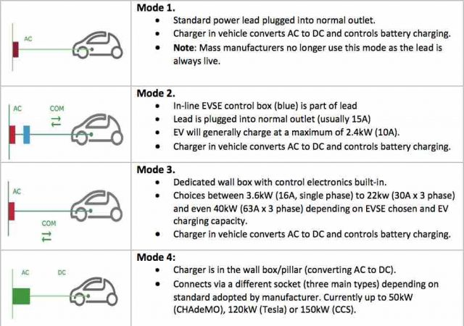
Description of Existing Method

Slide 13
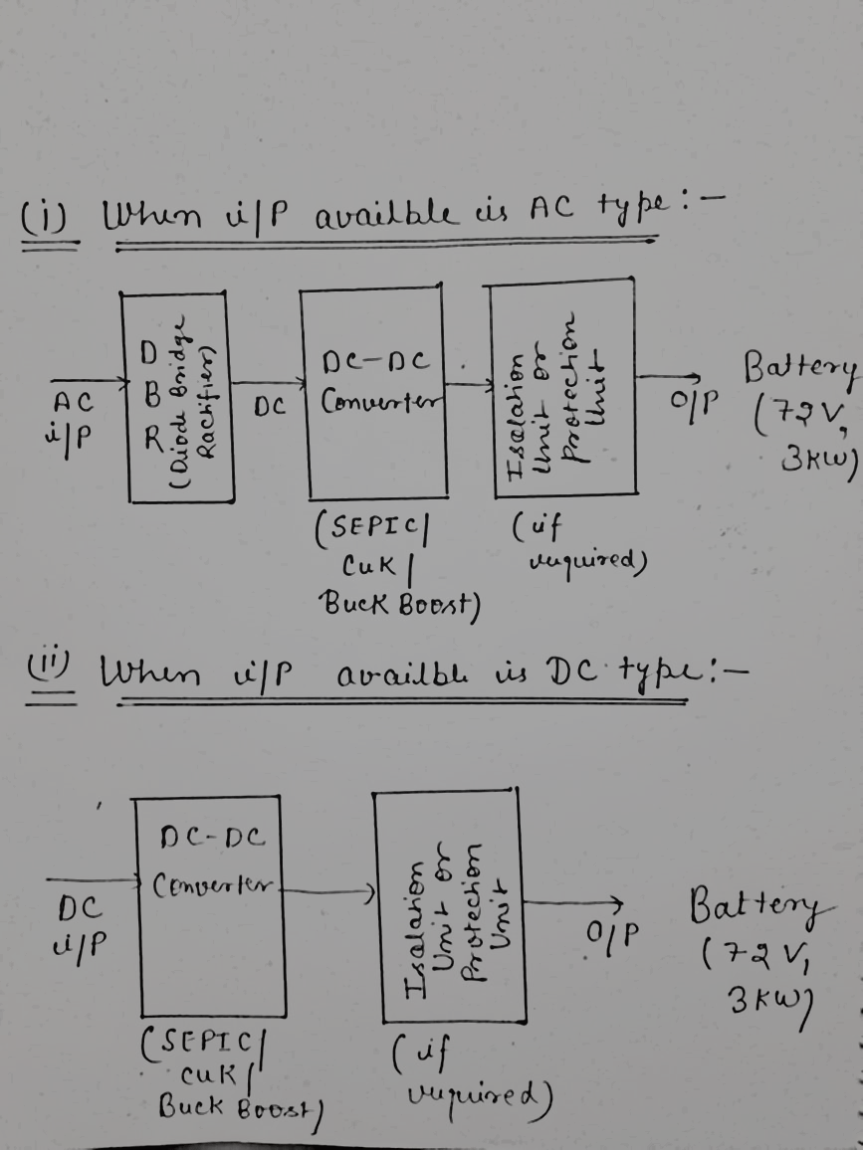
BLOCK DIAGRAM

Slide 14
TIMELINE
Task 1
Task 2
Task 3
Literature review and Selection of Battery Rating.
Simulation and comparison between cuk converter and SEPIC converter.
Task 4
Designing of the above selected converter for the power rating of the battery.
Task 5
Checking for the need of Protection Unit and completing the charger system.
October, 2020 – November, 2020
November, 2020 – December, 2020
Simulation and comparison between Buck-Boost converter and cuk converter.
January, 2021 – February, 2021
February, 2021 –March, 2021
March, 2021 – April, 2021

Slide 15
SIMULINK MODEL

Slide 16
Graphical/Tabular Results (applicable from 2nd presentation onwards)

Slide 17
Comparison of results among different techniques (applicable from 2nd presentation onwards)

Slide 18
References
[1] Amit Tripathi, Anurag Verma, “Design and Implementation of Cuk Converter for Power Factor Correction of PMBLDC Motor Drive”, International Journal of Recent Technology and Engineering (IJRTE) ISSN: 2277-3878, Volume-8, Issue-2S11, September 2019.
[2] Ryan Collin, Yu Miao, Alex Yokochi, Prasad Enjeti and Annette von Jouanne, “Advanced Electric Vehicle Fast-Charging Technologies”, Department of Electrical and Computer Engineering, Texas A&M University, College Station, TX 77843, USA, 15 May 2019.
[3] Sajib Chakraborty, Hai-Nam Vu, Mohammed Mahedi Hasan, Dai-Duong Tran, Mohamed El Baghdadi and Omar Hegazy, “DC-DC Converter Topologies for Electric Vehicles, Plug-in Hybrid Electric Vehicles and Fast Charging Stations: State of the Art and Future Trends”, ETEC Department & MOBI Research Group, Vrije Universiteit Brussel (VUB), Pleinlaan 2, 1050 Brussels, Belgium, 25 April 2019.
[4] Feyijimi Adegbohun, Annette von Jouanne and Kwang Y. Lee Autonomous Battery Swapping System and Methodologies of Electric Vehicles, Department of Electrical and Computer Engineering, Baylor University, Waco, TX 76798, USA,19 February 2019
[5] U.S. Energy Information Administration—EIA—”Independent Statistics and Analysis: Does the World Have Enough Oil to Meet Our Future Needs?”, 13 February 2019.
[6] Saharul Arof, N.Diyanah N.Ha , Philip Mawbyb , H. Arofc , Nurazlin Mohd Yaakopa, Electrical Electronic Automation Section, University Kuala Lumpur, Malaysian Spanish Institute, Kulim Hi-Tech Park, 09000 Kulim, Kedah, Malaysia 2019.
[7] Kishore Naik Mude, Battery Charging Method for Electric Vehicles: From Wired to On-Road Wireless Charging, Solace Power Inc., 1118 Topsail road Mount Pearl, Newfoundland and Labrador, A1N5E7, Canada,4 December 2018.
[8] 2018 Chevrolet Bolt EV Features & Specs ,31 October 2018.
[9] Pradeep Kumar Akhlaque Ahmad Khan Prabhat Ranjan Sarkar, “Single Switch AC-DC Cuk Converter for Power Factor and Efficiency Enhancement”, International Journal of Innovative Science and Research Technology, Volume 3, Issue 4, April – 2018

Slide 19
[10] Chevy EV Life: Bolt EV Charging Guide | Chevrolet , March 2018.
[11] S. Arof, N.M. Noor, F. Elias, P.A. Mawby, H. Arof, “Investigation of chopper operation of series Motor Four Quadrants DC Chopper”, Journal of Applied Environmental and Biological Science. J. Appl. Environ. Biol. Sci., 7(3S)49-56, 2017.
[12] S.Arof, H. Hassan, M. Rosyidi, P.A. Mawby, H. Arof, “Implementation of Series motor four quadrants Drive dc chopper for dc drive electric car and LRT”, Journal of Applied Environmental and Biological Science. J. Appl. Environ. Biol. Sci., 7(3S)73-82, 2017
[13] R. Kushwaha and B. Singh, "A Power Quality Improved EV Charger with Bridgeless Cuk Converter," 2018 IEEE International Conference on Power Electronics, Drives and Energy Systems (PEDES), Chennai, India, 2018, pp. 1-6, doi: 10.1109/PEDES.2018.8707701.[2] B. Zhao, A. Abramovitz and K. Smedley, “Family of bridgeless buck-boost PFC rectifiers,” IEEE Transactions Power Electronics, vol. 30, no. 12, pp. 6524-6527, Dec. 2015.
[14] Saharul Arof, Muhd Khairulzaman, A.K. Jalil, H. Arof, Mawby, P.A. (2015) “Self Tuning Fuzzy Logic Controlling Chopper Operation of Four Quadrants Drive DC Chopper for Low Cost Electric Vehicle”, 6th International Conference on Intelligent Systems, Modelling and Simulation, IEEE computer Society, p.p 40-24,. DOI: 10.1109/ISMS.2015.34
[15] Afida Ayob, Wan Mohd Faizal Wan Mahmood, Azah Mohamed, Mohd Zamri Che Wanik, “Review on Electric Vehicle, Battery Charger, Charging Station and Standards”, Department of Electrical, Electronic and Systems Engineering, University Kebangsaan, Malaysia 10 January 2014.
[16] K. T. Mok, Y. M. Lai, K. H. Loo, “A Single-Stage Bridgeless Power-Factor-Correction Rectifier Based on Flyback Topology,” in Proc. of 33rd Int. IEEE Telecom. Conf. (INTELEC), 9-13 Oct. 2011, pp. 1-6.
[17] A. Abramovitz, and K. M. Smedley, “Analysis and design of a tapped-inductor buck-boost PFC rectifier with low bus voltage,” IEEE Trans. Power Electronics, vol. 26, no. 9, pp. 2637–2649, Sep. 2011.
[18] Yimin Gao and Mehrdad Ehsani, (2010) “Design and Control Methodology of Plug-in Hybrid Electric Vehicles”, IEEE Trans. Ind. Electron, VOL. 57, NO. 2, pp 633-640.
[19] L. Huber, J. Yungtaek, M. M. Jovanovic, "Performance Evaluation of Bridgeless PFC Boost Rectifiers," Applied Power Electronics Conference, APEC 2007 - Twenty Second Annual IEEE , vol., no., pp.165-171, Feb. 25 2007-March 1 2007.

Slide 20
[20] Pradeep Kumar, Akhlaque Ahmad Khan, Prabhat Ranjan Sarkar, Electrical Engineering Department, Integral University, Lucknow, India, Single Switch AC-DC Cuk Converter for Power Factor and Efficiency Enhancement, 4 April 2018.
[21] Zeeshan Rayeen, Sourav Bose, Prakash Dwivedi, Department of Electrical Engineering, NIT Uttarakhand, India, Study of Closed loop Cuk converter controlled by Loop Shaping Method, 2018.
[22] Sofyan M. Ilman, Andriazis Dahono, Muhammad Aji K. Prihambodo, School of Electrical Engineering and Informatic Bandung Institute of Technology Bandung, Indonesia, 2019.
[23] P.Nagalakshmi Kanna, Dr.B.Meenakshi, Department Of EEE, Sri Sai Ram Engineering College, Chennai, Tamil Nadu, India, Analysis and Design of DC- DC/AC Non Isolated Cuk Converter using Sliding Mode Controller, 2015.
[24] Wenzheng Xu, K.W.E Cheng, K.W.E Chan, Department of Electrical Engineering, The Hong Kong Polytechnic University, Hong Kong, Application of Cuk converter together with Battery Technologies on the Low Voltage DC supply for Electric Vehicles, 2018.
[25] S. Sivajanani,N. Veeramuthulingam, N. Arunkumar, D. Balaji, Department of Electrical and Electronics Engineering, Manakula Vinayagar Institute of Technology Puducherry, India, Analysis of Cuk Converters for Power Factor Correction Applications, 5 May 2014.
[26] J. Hoyo, J. Alcala and H. Calleja, Department of Electronics, Interior Intemado Palmira s/n. Cuernavaca, Mor., Mexico,A High Quality Output AC/AC Cuk Converter, 2004.
[27] N.A.A. Isa, W.M. Utomo, M. K. R. Noor, M.A.Z.A. Rashid, A.F.H.A. Gani, A.A. Bakar, S.S. Yi, Iradiatu Diah P K, Performance Between PFC Cuk and Bridgeless PFC Cuk Converter with Various Output Voltages, July 2019.
[28] L. Huber, Y. Jang, and M. Jovanovic, “Performance evaluation of bridgeless PFC boost rectifiers,” IEEE Transactions Power Electronics, vol. 23, no. 3, pp. 1381–1390, May 2008.

Slide 21
[29] B. Zhao, A. Abramovitz and K. Smedley, “Family of bridgeless buck-boost PFC rectifiers,” IEEE Transactions Power Electronics, vol. 30, no. 12, pp. 6524-6527, Dec. 2015.
[30] A. A. Fardoun, E. H. Ismail, A. J. Sabzali and M. A. Al-Saffar, “New Efficient Bridgeless Cuk Rectifiers for PFC Applications,” IEEE Transactions on Power Electronics, vol. 27, no. 7, pp. 32923301, July 2012.
[31] H. Nene, C. Jiang, and S. Choudhury, “Control for Light Load Efficiency and THD Improvements in PFC Converter,” pp. 1785–1788, 2017.
[32] H. T. Yang, H. W. Chiang, and C. Y. Chen, “Implementation of Bridgeless Cuk Power Factor Corrector With Positive Output Voltage,” IEEE Trans. Ind. Appl., vol. 51, no. 4, pp. 3325–3333, 2015.
[33] . Sabzali, E. H. Ismail, M. A. Al-Saffar, and A. A. Fardoun, “A new bridgeless PFC Sepic and Cuk rectifiers with low conduction and switching losses,” 2009 Int. Conf. Power Electron. Drive Syst., pp. 550–556, 2009
[34] Y. Jang and M. M. Jovanovi´ c, “Bridgeless high-power-factor buck converter,” IEEE Trans. Power Electron., vol. 26, no. 2, pp. 602– 611, Feb.2011
[35] B. Zhao, A. Abramovitz and K. Smedley, “Family of bridgeless buck-boost PFC rectifiers,” IEEE Transactions Power Electronics,vol. 30, no. 12, pp. 6524-6527, Dec. 2015.
[36] Somayajula, D., & Ferdowsi, M. (2009), “Power Sharing in a Double-Input Buck-boost Converter Using Offset Time Control” 2009.

Slide 22
[37] Somayajula, D., & Ferdowsi, M. (2010), “Small-signal modelling and analysis of the double-input buck-boost converter” 2010
[38] Veerachary, M. (2018), ”Design and Analysis of Fifth-order Buck-Boost Converter”, 2018 2nd IEEE International Conference on Power Electronics, Intelligent Control and Energy Systems”
[39] Jaschke, R. (2007), ”Conduction Losses in DC/DC-Converters as buck-boost/boost-buck synchronous rectifier types” 2007 Compatibility in Power Electronics.
[40] R. M. Schupbach, J. C. Balda, M. Zolot, and B. Kramer, “Design methodology of a combined battery-ultracapacitor energy storage unit for vehicle power management,” in Proc. IEEE Power Electronics Conf., 15-19 Jun. 2003, vol. 1, pp. 88-93.
[41] Tsai-Fu Wu; Yu-Kai Chen. “A systematic and unified approach to modelling PWM DC/DC converters based on the graft scheme”, IEEE Transactions on Industrial Electronics, vol. 45, no.1, pp. 88-98, Feb. 1998.
[42] A. A. Fardoun, E. H. Ismail, “Bridgeless SEPIC rectifier with unity power factor and reduced conduction losses,” IEEE Trans. Ind. lectron., vol. 56, no.4, pp. 1147–1157, April 2009.
[43] Y. M. Chen, Y. C. Liu, and F. Y. Wu, “Multi-input converter with power factor correction, maximum power point tracking, and ripple-free input currents”, IEEE Trans. Power Electronics, vol. 19, pp. 631-639, May 2004.
[44] W. Sutopo, M. Nizam, B. Rahmawatie and F. Fahma, "A Review of Electric Vehicles Charging Standard Development: Study Case in Indonesia," 2018 5th International Conference on Electric Vehicular Technology (ICEVT), Surakarta, Indonesia, 2018, pp. 152-157, doi: 10.1109/ICEVT.2018.8628367.
[45] Pandav Kiran Maroti, Sanjeevi Kumar Padmanaban, Jens Bo Holm-nielsen, Mahajan Sagar Bhaskar, Mohammad Meraj, Atif Iqbal, “A New Structure of High Voltage Gain SEPIC Converter for Renewable Energy Applications”, IEEE ACCESS, July 23, 2019. (Journal)

Slide 23
[46] Ibrahim A. AlMohaisin , Ahmed A. Mahfouz , V. T. Akhila, “A Review on SEPIC Converter Topologies”, International Journal of Research in Engineering, Science and Management Volume-2, Issue-12, December-2019.(Journal)
[47] H. Suryoatmojo, I. Dilianto, Suwito, R. Mardiyanto, E. Setijadi and D.C. Riawan, “Design and Analysis of High Gain Modified SEPIC Converter for Photovoltaic Applications”, 2018 IEEE International Conference on Innovative Research and Development (ICIRD) 11-12 May 2018.(Research Paper)
[48] Jingying Hu, Anthony D. Sagneri, Juan M. Rivas, Yehui Han, Seth M. Davis, David J. Perreault, “High Frequency Resonant SEPIC Converter with Wide Input and Output Voltage Ranges”, IEEE TRANSACTIONS ON POWER ELECTRONICS, Vol. 27, No. 1, pp. 189-200, Jan. 2012.(Research Paper)
[49] Trivedi Bhavin, Bhavesh Patel, Jay Desai, Kamlesh Sonwane, ” Analysis of SEPIC Converter”, IJEDR 2018.(Journal)
[50] Gajalakshmi M, Dr Karpagavalli P, ”Design and Analysis of a SEPIC Integrated Boost (SIB) Converter using Coupled Inductor”, International Research Journal of Engineering and Technology (IRJET), Volume: 07 Issue: 03, March, 2020.(Journal)
[51] O. Kircioğlu, M. Ünlü and S. Çamur, "Modeling and analysis of DC-DC SEPIC converter with coupled inductors," 2016 International Symposium on Industrial Electronics (INDEL), Banja Luka, 2016.(Research Paper)
[52] Fakirrao T.Chavan, Shrikant S.Mopari , Panchayya S. Swami, “Performance Analysis Of SEPIC And Zeta Converter For Power Quality Improvement”, INTERNATIONAL JOURNAL OF SCIENTIFIC & TECHNOLOGY RESEARCH VOLUME 8, ISSUE 12, DECEMBER 2019.(Journal)
[53] Subramani Saravanan, Neelakandan Ramesh Babu, “A modified high step-up non-isolated DC-DC converter for PV application”, Journal of Applied Research and Technology, May 15, 2016.(Journal)

Slide 24
THANK YOU

